Slide 1
Project 2 Meal Planning Problem
Group 3: Jiacheng Yu, Ting Pan, Lei Lei, Ruixin Wu

Slide 2
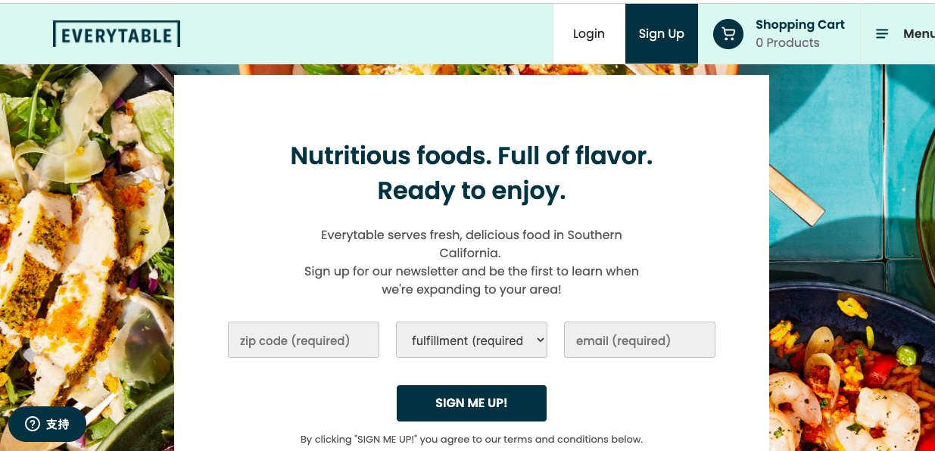
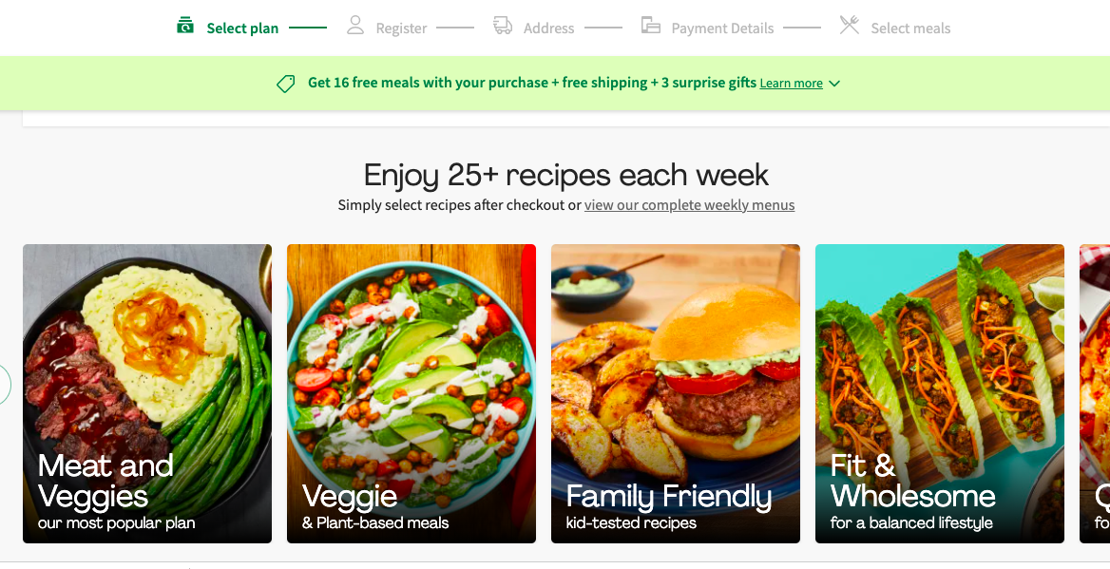
Project Overview
In this project, we are going to generate weekly meal plans for our team members based on the personal ratings information and constraints. It can be divided into two parts:
1) Matrix Completion: solving MAP problem to fulfill the sparse ratings data by Coordinate Ascent Algorithm.
2) Mixed Integer Programming: constructing a Mixed Integer Programming (MIP) model to maximize the sum of ratings based on our predicted matrix and constraints as well as making the arrangement of our chefs.

Slide 3
Part I
Matrix Completion Problem

Slide 4
Overview
In part one, our aim is to achieve matrix completion to obtain the predicted ratings matrix MP.
First, we convert the json format data into pandas dataframe, build the rating matrix M and extract the personal ratings information (rows: customers, columns: dishes, cells: ratings).
Second, we enlarge the matrix M with additional rows being the ratings from each team member
Third, we fulfill the sparse matrix through matrix completion technique(MAP) which references Coordinate Ascent Algorithm.

Slide 5
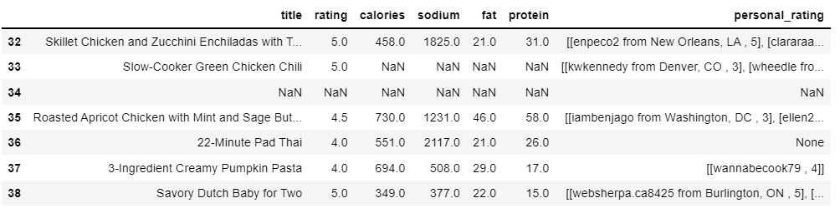
Data Cleaning
Read ‘result.json’ file in Python
Remove NaN values in ‘title’
Standardize values in ‘personal_rating’

Slide 6
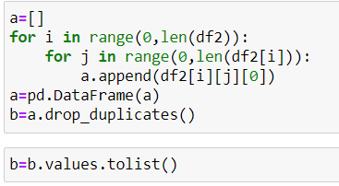
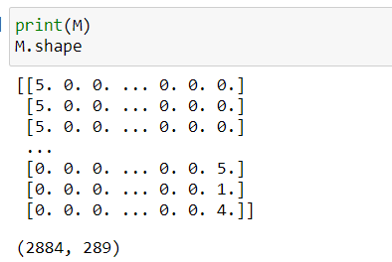
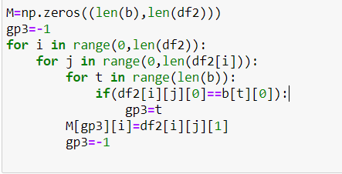
Create the Sparse Matrix M
Generate the sparse matrix M (2884*289) from original dataframe

Slide 7
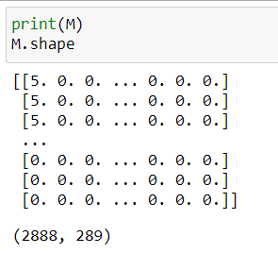
Enlarge the Sparse Matrix M
Each team member rate 8 different dishes
2884+4 = 2888 rows and 289 columns

Slide 8
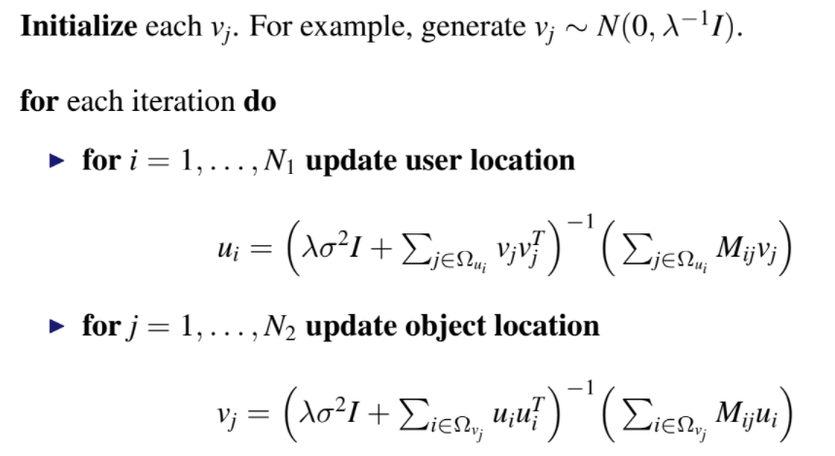
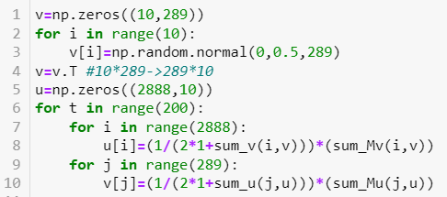
Complete the Matrix M
Follow the Matrix Factorization instructions on Page 13 to write functions
We have 200 iterations to find the Ui, Vj, and they converge in the end

Slide 9

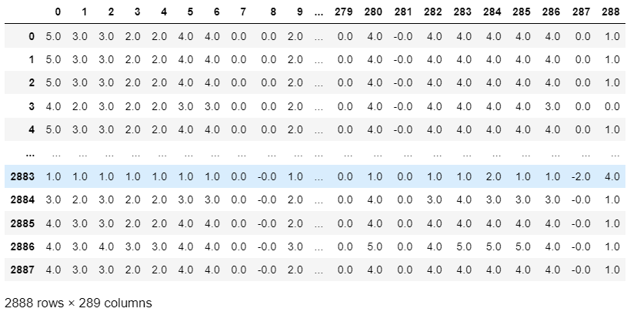
Complete the Matrix M
Get the completed predicted Matrix: (MP = U*V.T)
Ensure ratings of user i rounded to the closest integer

Slide 10
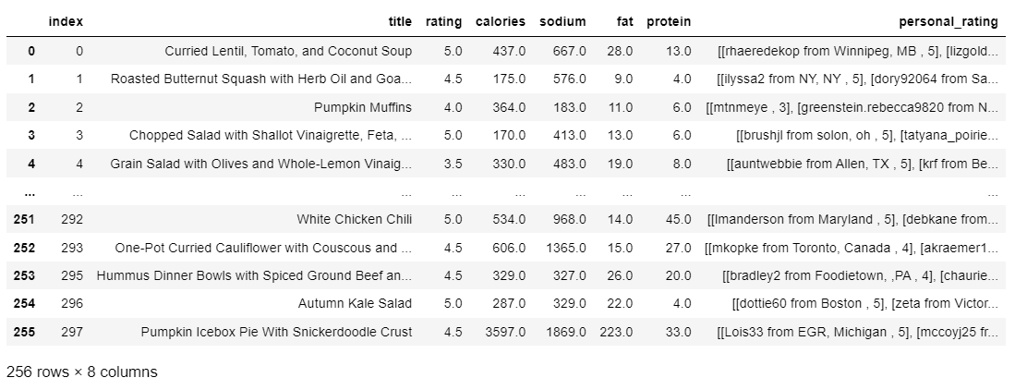
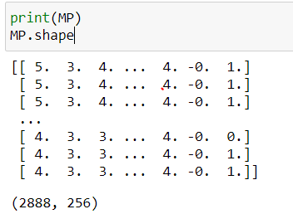
Further Data Cleaning
We wanted to have more known ratings to predict unknown ratings at the beginning
Remove 33 rows with NaN values in ‘calories’, ‘sodium’, ‘fat’, ‘protein’ now (Also remove those columns in Matrix)
289-33 = 256 rows → 256 dishes

Slide 11
Part II
Mixed Integer Programming
(Meal Plan Recommendation)

Slide 12
Overview
In part two, our aim is to maximize the sum of team members’ ratings with given constraints and decide who to cook each dinner
First, based on the predicted matrix MP we got from part one, we choose the last four rows. Then we set up the variables, objective function and constraints in order to maximize ratings and satisfy requirements (e.g. dishes arrangement, nutrients, budget).
By solving the problem, finally we got the optimal dishes arrangement for each dinner with maximal total ratings, and meets all constraints and requirements.
Then we set up another Mixed Integer Model to assign our team members to cook for each dinner based on equity and availability.

Slide 13

Model Set-up
Basic Assumption
For our group members, all members eat one same dish for each dinner from Monday to Friday(5-day)
We eat 1 meal(only dinner) together one day cooked by one member.
Goal is to find out the arrangement of the 256 dishes for each dinner and the optimal cooking arrangement
Binary Variables
x[ i, t ] ∈ { 0, 1 }
day
dish
i ∈ [1:5] t ∈ [1:256]
x[i,t]=1 means we choose dish t on day i
x[i,t]=0 means we don’t choose dish t on day i

Slide 14



Model Set-up
Objective Function
To maximize the Total sum of the total ratings made by four members of each dish we choose for each dinner.
Constraints（Arrangement）
We recommend only one dish for each meal.
Ensure that each dish only appears once in our recommendation.

Slide 15
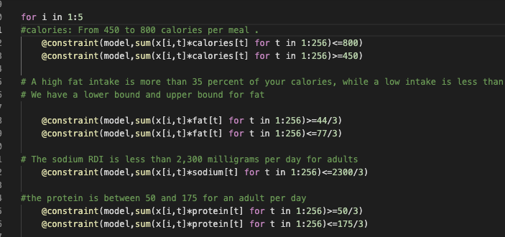
Model Set-up
Constraints(nutrients)
We recommend only one dish for each meal.
Ensure that each dish only appears once in our recommendation.
The nutritional requirements per meal are shown as follows:
 | min | max
Calories | 450 | 800
Fat | 44/3 | 67/3
Sodium | - | 2300/3
Protein | 50/3 | 175/3

Slide 16


Model Set-up
Constraints(others)
We recommend only one dish for each meal.
Ensure that each dish only appears once in our recommendation.
The nutrients requirement is shown as follows.
Our budget per person per meal is $20.
We assumed the price of each dish ranges from $6 to $25. Therefore, we generated 256 numbers range between 6 to 25 randomly to represent the prices.
Then we build budget constraints
Arrangement
Nutrients
Budget

Slide 17


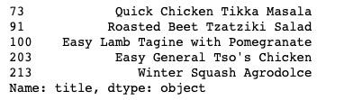
Running Result
Optimal Ratings
The optimal objective value of the model is 75, indicating that the sum of ratings for dishes we choose is 75. Because we have 4 people, 5 days, so the average rating per meal we recommend is 75/20=3.75
Meal Plan Recommendation

Slide 18
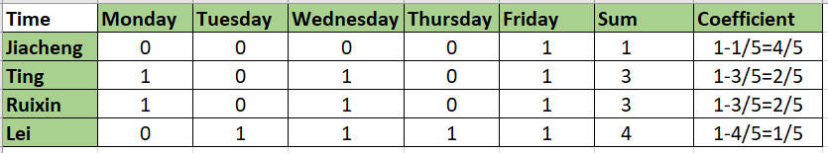
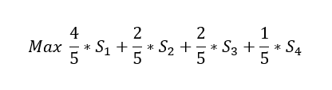

Cooking time (Considering Equity)
In this part, we set up another Mixed Integer Model to assign our team members to cook for each dish based on availability and we also consider equity (Creative idea)(Linear)
Constraint: Members with more time are assigned with more work.
Objective function:
We try to prioritize assigning work to members with less cooking time when they are available

Slide 19
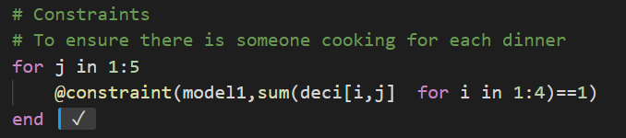
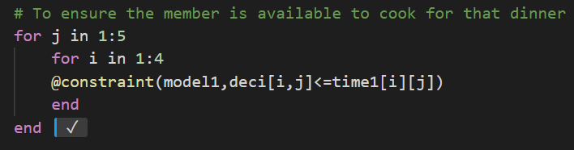
Cooking time
Availability

Slide 20
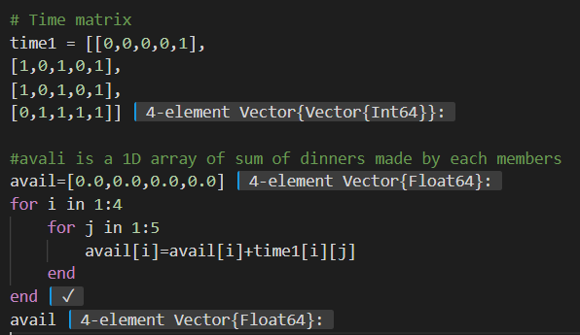
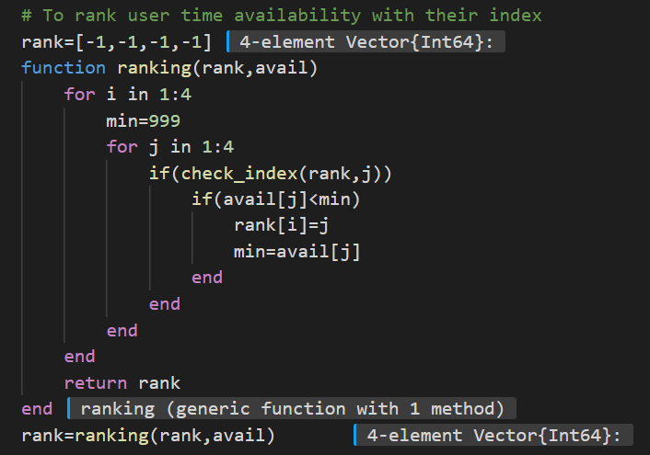
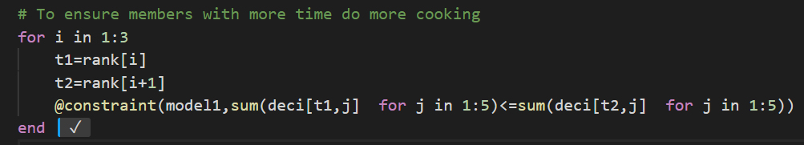
Cooking time (Considering Equity)
Considering Equity

Slide 21
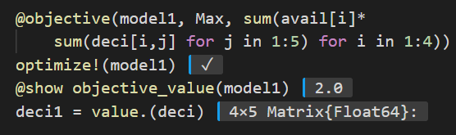
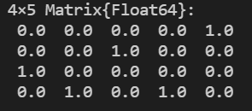
Cooking time (Considering Equity)
Result:

Slide 22
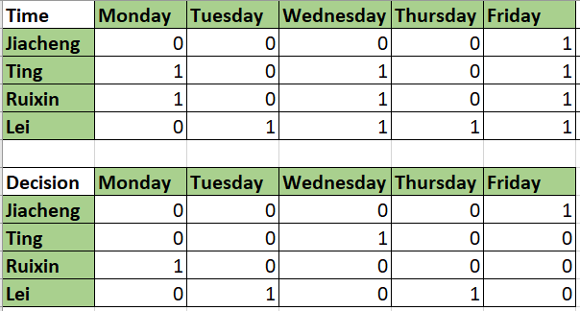
Assignment

Slide 23
Our Dinner Menu and Chief Arrangement
 | Dinner | Chief
Monday | Quick Chicken Tikka Masala | Ruixin Wu
Tuesday | Roasted Beet Tzatziki Salad | Lei Lei
Wednesday | Easy Lamb Tagine with Pomegranate | Ting Pan
Thursday | Easy General Tso’s Chicken | Lei Lei
Friday | Winter Squash Agrodolce | Jiacheng Yu

Slide 24
Future work and innovation
Although our groups don’t have any food allergies, we can enrich our MIP model by taking more practical requirements into consideration. For example, we can add distance restrictions (Group members’ and markets’ addresses ).
Given that we generated the price of each dishes randomly within a range, we can do further research on the prices of dishes to make them more realistic.
For all 256 dishes in our dataset, some of them might not suitable for dinner (like soup, salad) and we have arranged “Chicken” in two days of a week. Thus, in the future, we can try to categorize those dishes to make our suggestion more diversified.
Based on the theory, we can design a smart application to recommend meal plans for more and more people.

Slide 25
Thanks for listening!

